Slide 1

Screening
S
Q
L
Kunal Gola
Notes:
Introduction of Kunal Gola:

Slide 2
SQL
SQL, which stands for Structured Query Language, is a programming language used for managing and manipulating relational databases.
Notes:
It allows users to create, edit, and retrieve data from databases, making it a powerful tool in various fields such as web development and data analysis.

Slide 3
Introduction
Structured Query Language
a declarative language
widely used in dbms
It is a programming language used for managing and manipulating relational databases.
It focuses on specifying what data should be retrieved or modified, rather than how it should be done.
It allows users to interact with databases to perform tasks such as querying data, inserting or updating records, and creating or modifying database structures.
Notes:
SQL is a special-purpose programming language designed for managing data in a relational database management system (RDBMS).
It focuses on specifying what data should be retrieved or modified, rather than how it should be done.
Widely used in DBMS as a data definition and manipulation language
It allows users to insert, update, delete, and retrieve data from databases. and
It enables the creation, modification, and deletion of database objects such as tables, views, and indexes.

Slide 4
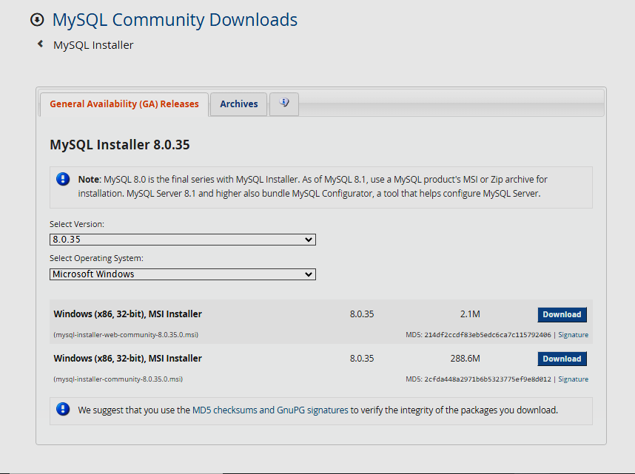
Installation on windows
Download MySQL Installer
Go to the MySQL official website: MySQL Downloads.
Run MySQL Installer
Once the installer is downloaded, run the executable file (.exe) to start the MySQL Installer.
MySQL Installer Setup
Select "Developer Default" for a typical installation that includes MySQL Server, MySQL Workbench, and other tools.
Complete the Installation
Follow the on-screen instructions to complete the installation.
Notes:
Here are the steps to install MySQL on Windows:
1. **Download MySQL Installer:**
- Go to the MySQL official website: [MySQL Downloads](https://dev.mysql.com/downloads/).
- Under the "MySQL Installer for Windows" section, download the MySQL Installer for Windows.
2. **Run MySQL Installer:**
- Once the installer is downloaded, run the executable file (`.exe`) to start the MySQL Installer.
3. **MySQL Installer Setup:**
- The MySQL Installer provides a graphical interface for installing MySQL products. Choose the setup type based on your requirements. You can select "Developer Default" for a typical installation that includes MySQL Server, MySQL Workbench, and other tools.
4. **Complete the Installation:**
- Follow the on-screen instructions to complete the installation. You will be prompted to configure MySQL Server, set a root password, and choose other configuration options.
After completing these steps, MySQL should be installed on your Windows system. You can then use MySQL Workbench or other MySQL clients to connect to the server and manage your databases.

Slide 5
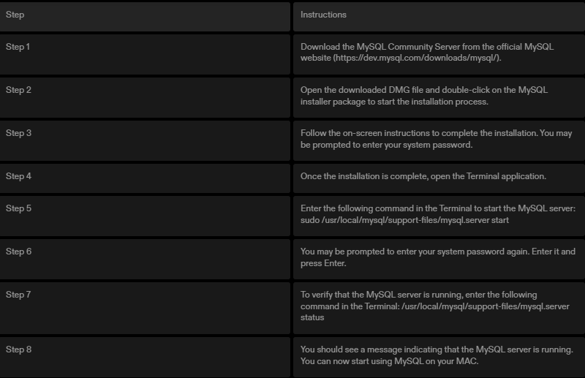
SQL Installation in detail
Notes:
These are the detailed steps of SQL installation of Server, workbench and shell.
We can follow them for completing the installation.
After installation we can move on to the database creation.

Slide 6
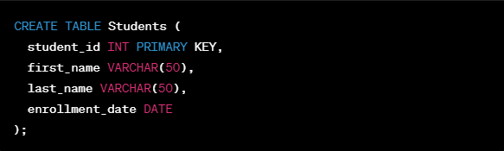
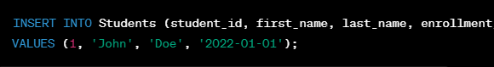
Creating the Database
Database Design
Accessing MySQL
Creating a New Database
Switching to the Database
Creating Tables
Inserting Data
Checking the Database Structure
Notes:
Steps to Create a Database:
Database Design:
Before creating a database, it's crucial to design it. Consider the entities, relationships, and attributes relevant to the subject matter of the course.
For example, if the course is related to a university, entities might include students, courses, and professors.
Accessing MySQL:
On your MySQL server, either locally or remotely, access the MySQL command-line interface or a graphical interface like MySQL Workbench.
Creating a New Database:
Use the CREATE DATABASE statement to create a new database. For instance: CREATE DATABASE CourseDatabase;
Switching to the Database:
After creating the database, switch to it using the USE statement: USE CourseDatabase;
Creating Tables:
Design tables based on the entities identified earlier. Specify the columns, data types, and any constraints.
Example for creating a Students table:sqlCopy code
CREATE TABLE Students ( student_id INT PRIMARY KEY, first_name VARCHAR(50), last_name VARCHAR(50), enrollment_date DATE );
Inserting Data:
Populate the tables with sample data to work with during the course.
Example for inserting a student record: INSERT INTO Students (student_id, first_name, last_name, enrollment_date) VALUES (1, 'John', 'Doe', '2022-01-01');
Checking the Database Structure:
Use commands like DESCRIBE or SHOW COLUMNS to inspect the structure of tables.
Example: DESCRIBE Students;
A database most often contains one or more tables. Each table is identified by a name , and contain records (rows) with data.
SQL keywords are NOT case sensitive
Some database systems require a semicolon at the end of each SQL statement.

Slide 7
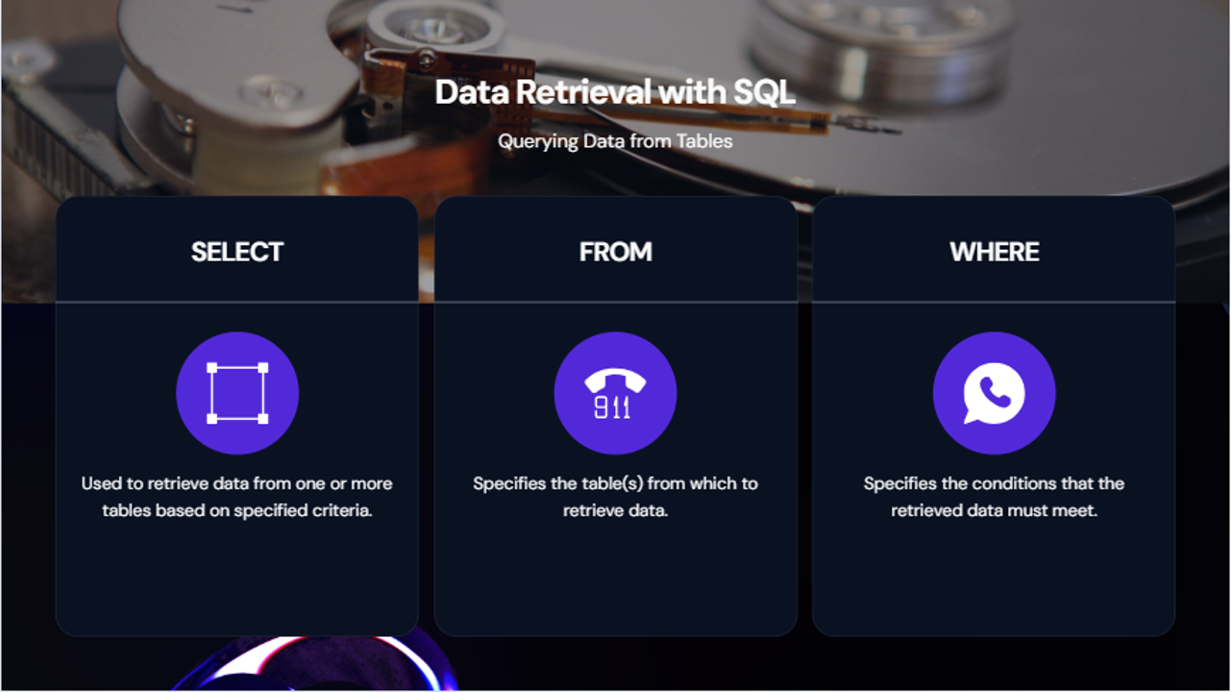
Notes:
Mastering SELECT, FROM, and WHERE is foundational for effective data retrieval in SQL.
These commands provide the flexibility to extract the specific information needed from large datasets.

Slide 8
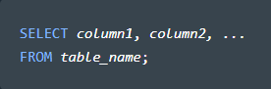

Select statement
The SELECT statement is used to select data from a database.
Example:
Syntax
Select ALL columns
Functions
Column Selection
Aggregate Functions
Grouping Data
Notes:
It allows users to create, edit, and retrieve data from databases, making it a powerful tool in various fields such as web development and data analysis.
Functions:
Exploring the SELECT clause for specifying columns to be retrieved.
Understanding functions like COUNT, SUM, AVG, and MAX for data summarization.
Implementing GROUP BY clause for data grouping and aggregation.

Slide 9
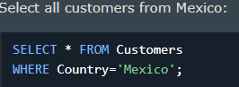
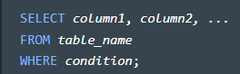
where statement
The WHERE clause is used to filter records.
It is used to extract only those records that fulfill a specified condition.
Example:
Syntax:
Functions:
Conditional Filtering
Combining Conditions
Case Study: Advance Filtering using operators
Notes:
The WHERE clause is an essential component of SQL queries as it allows you to filter data based on specific conditions. By using the WHERE clause, you can specify criteria that must be met for the data to be retrieved. This helps you narrow down the results and retrieve only the data that meets your specified conditions.
The syntax for using the WHERE clause in a SELECT statement is as follows:

Slide 10
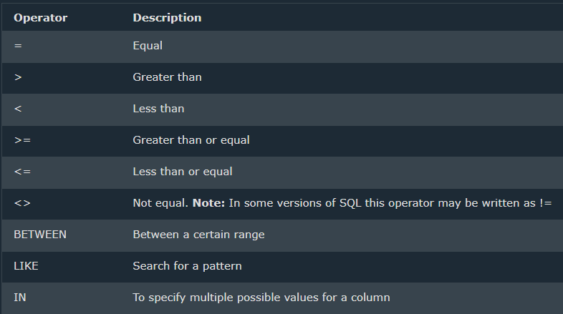
where statement
Operators in the where clause
Notes:
The WHERE clause is an essential component of SQL queries as it allows you to filter data based on specific conditions. By using the WHERE clause, you can specify criteria that must be met for the data to be retrieved. This helps you narrow down the results and retrieve only the data that meets your specified conditions.
The syntax for using the WHERE clause in a SELECT statement is as follows:

Slide 11

where statement
Notes:
The WHERE clause is an essential component of SQL queries as it allows you to filter data based on specific conditions. By using the WHERE clause, you can specify criteria that must be met for the data to be retrieved. This helps you narrow down the results and retrieve only the data that meets your specified conditions.
The syntax for using the WHERE clause in a SELECT statement is as follows:

Slide 12

The And, or and not operators
The WHERE clause can contain one or many AND, NOT and OR operators.

Slide 13
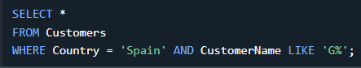
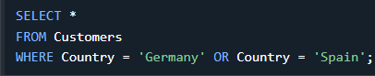
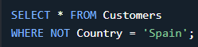
AND, OR, NOT operators
AND
OR
NOT
All Conditions must be true
SYNTAX
SELECT column1, column2, ...
FROM table_name
WHERE condition1 AND condition2 AND condition3 ...;
The OR operator displays a record if any of the conditions are TRUE.
Syntax
SELECT column1, column2, ...
FROM table_name
WHERE condition1 AND condition2 AND condition3 ...;
Syntax
SELECT column1, column2, ...
FROM table_name
WHERE NOT condition;
There are various ways to use the NOT operator NOT LIKE, NOT BETWEEN, NOT IN, NOT >, NOT <
Notes:
The AND operator is used to filter records based on more than one condition, like if you want to return all customers from Spain that starts with the letter 'G’:
The OR operator is used to filter records based on more than one condition, like if you want to return all customers from Germany but also those from Spain:
The NOT operator is used in combination with other operators to give the opposite result, also called the negative result.

Slide 14

Conclusion
In conclusion, SQL (Structured Query Language) is a powerful tool for managing and querying relational databases. Throughout this presentation, we've covered key aspects of SQL, including its installation, basic commands, and essential operators.
Notes:
Conclusion:
SQL empowers us to interact with and derive meaningful information from databases. Whether you are a beginner or an experienced developer, embracing SQL opens up possibilities for effective data management and analysis.

Slide 15


Thank you
Kunal Gola
kunalgola9930@gmail.com
B.Tech. CS 8th semester YMCA
+91 9811363765
Notes:
Thank You for Your Attention!
We appreciate your time and engagement throughout this presentation. If you have any questions or discussions, feel free to ask.

